Slide 1
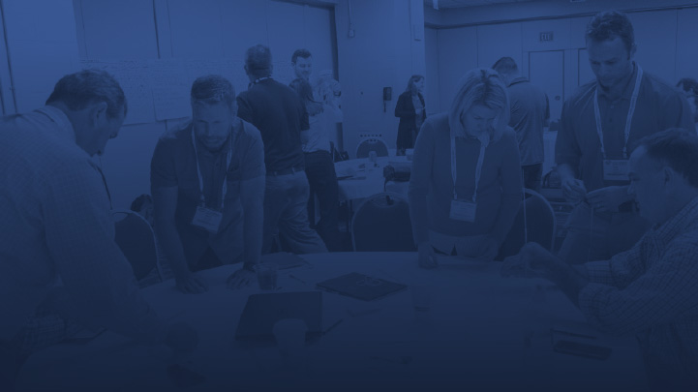

02_Exploring the 8 Wastes
LCI Lean Learning Series
Facilitators Name
Date
© LEAN CONSTRUCTION INSTITUTE

Slide 2
Conditions of Satisfaction
The presentation materials are the copyright of the Lean Construction Institute.
Slides or material may not be copied or used in any way other than this presentation.
The presentation may be shared in PDF format only with the participants.

Slide 3
LCI Lean Learning Series
This LCI Lean Learning Series is a facilitated discussion on a particular subject matter, having to do with Lean Project Delivery, ideally leading the participants into new action.
Conducting the Discussion:
The Facilitator shares the presentation allowing discussion along the way.
Consider arranging the seating in a circle or other manner to support cross discussion among participants.
Discussion questions are included to trigger a conversation.
The Facilitator should ensure that all participants engage.
The wrap up should include each participant sharing something new they learned.

Slide 4
Topic Description
2_ Exploring the 8 Wastes
This topic focuses on the 8 Wastes as relevant to the design and construction industry.
Participants will learn the definition of waste and descriptions of each of the 8 Wastes with examples for further exploration. Learning will include a before and after waste walk video example.
Note: For AIA or other Continuing Education Credits, participants will need to self-report attendance and learning.

Slide 5
Lean Journey to Mastery
How will you reach the next level on your journey?
Mastery
Competency
Understanding
Continuous Learning Cycle(s)
Awareness
Unaware
Notes:
Lean is a journey involving continuous improvement and learning
This Discussion takes a participant from a place of relative unawareness to awareness on the Journey to Mastery. Note that as one moves from understanding to competency, the journey takes on a continuous learning loop. And at Mastery we realize how much more there is to learn☺

Slide 6
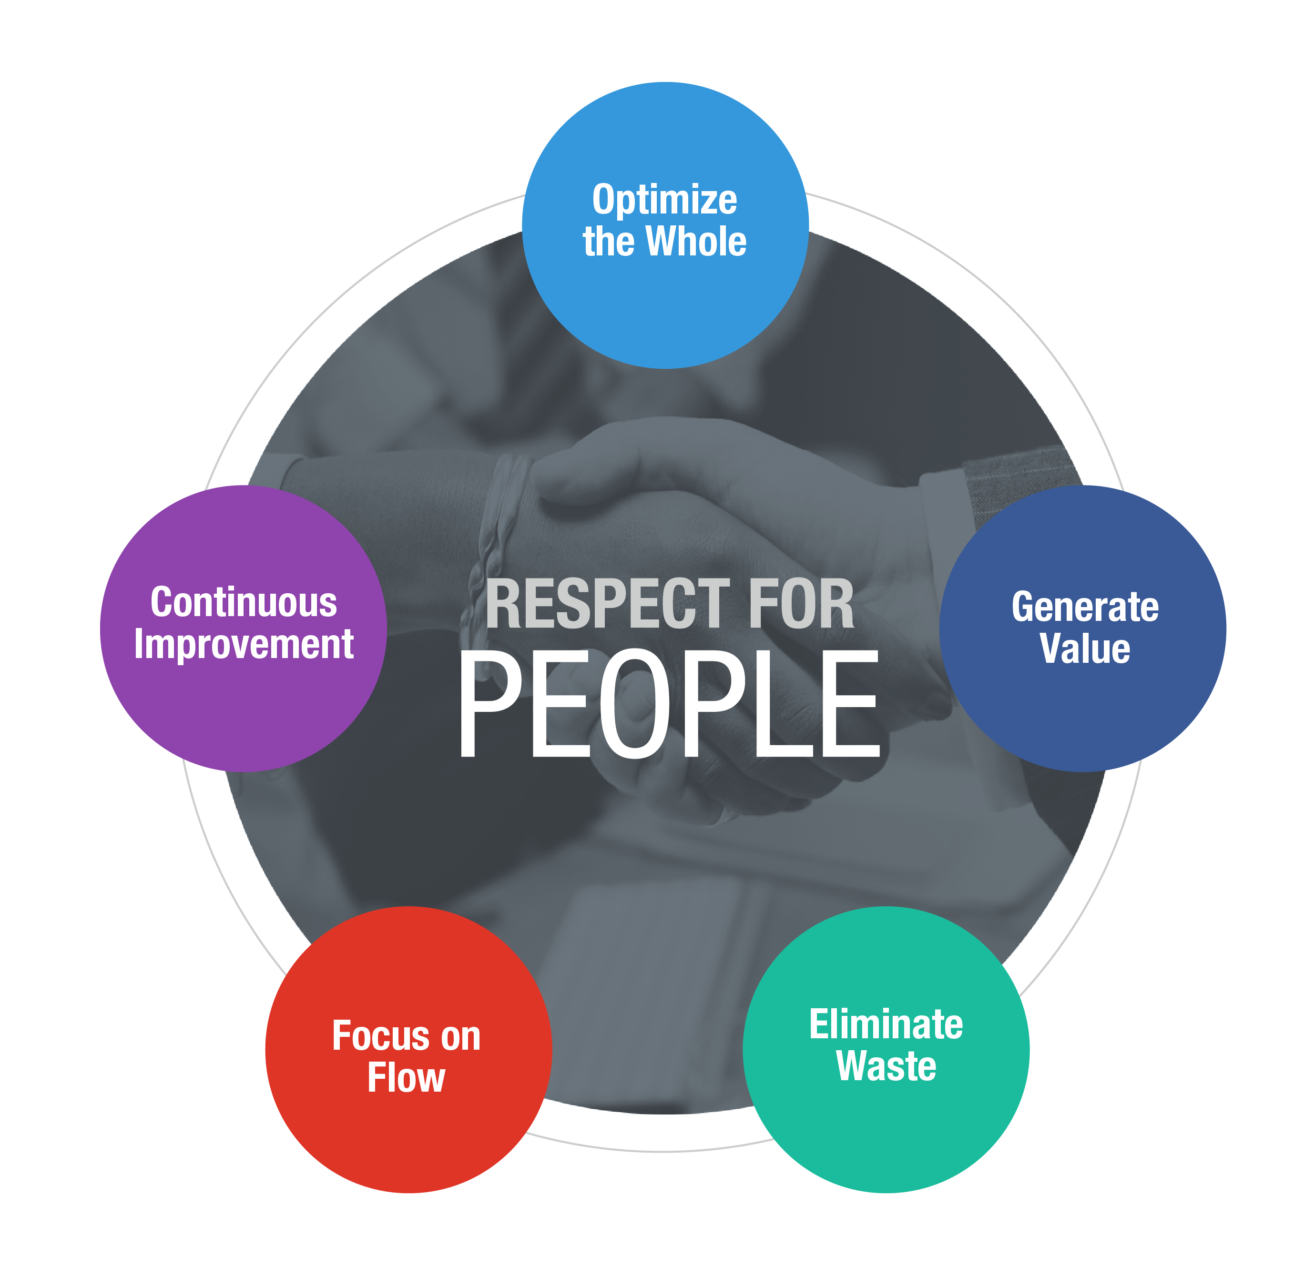
Lean:
Definitions
A culture of respect and continuous improvement aimed at creating more value for the customer while identifying and eliminating waste.
Lean Project Delivery System:
An organized implementation of Lean Principles and Tools combined to allow a team to operate in unison to create flow.
Notes:
Discuss how the key terms underlined work together to support the overall definition of each term. Lean is not 1 thing.

Slide 7
Six Tenets of Lean
1
Respect for people
2
2
Optimize the Whole
3
Generate Value
4
Eliminate Waste
5
Focus on Flow
6
Continuous Improvement
Notes:
1. Respect for People: People transform ideas and materials into value. People are essential to Lean project delivery so they must collaborate within and across teams using foundational Lean principles with the goal of optimizing overall value.
2. Optimize the whole, not just the parts: Most conversation about Lean focuses on the use of Lean tools, which lead to tactical implementation of Lean approaches. Beneath the tools, however is a shift in how people and teams view processes. It requires that teams continuously learn, identify value and eliminate waste for the betterment of the overall project.
3. Focus on customer-defined value: Team members have the ability to understand and refine the definition of value from the customer’s point of view, and this definition becomes increasingly clear through the life of the project.
4. Eliminating waste: If we focus on what is of value, we can then stop doing the things that are not adding value, the waste. There are 8 categories of waste including: defects, waiting, transportation of goods, motion, inventory, overproduction, and unnecessary process steps. You can not remove waste until you know what is of value.
5. Focus on process and flow: Project team members collaboratively find ways to eliminate non-value adding steps, which shortens the process, all while focusing on flow efficiency.
6. Mindset of continuous improvement: Leaders must create an environment where experimentation is encouraged within project constraints and small, manageable failure is acceptable if the goal is to continuously improve. This atmosphere can drive innovation that will benefit the entire value stream. Lean is a focus on continual learning. If you are striving towards a specific end where the learning is done you will lose a key component of Lean. It’s about collaborating sharing ideas, evolving and refining approaches.

Slide 8







Eight Types of Waste
Waste is any activity that requires time or resources, but does not create value for the customer.
Over/Under Production
Excess Inventory
Waiting
Unnecessary Motion
Unnecessary Transportation
Defects
Over Processing
Unused Creativity of Team Members
(Not listening/Not speaking up)
Notes:
The following slides will give a definition and examples of each waste for discussing.

Slide 9
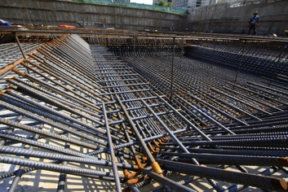
Over/Under Production
Making something before it is truly needed. Not producing the right work at the right time in the right amount as needed by the downstream work.
An example of over production is highly detailing millwork drawings beyond a level that gets design intent and quality across, especially when they will be detailed by the millwork trade.
An example of under production is missing or unclear information on drawings that leads to confusion or a Request for Information (RFI).
Each of these can lead to the waste of waiting.

Slide 10
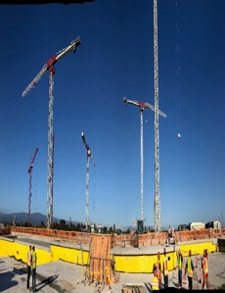
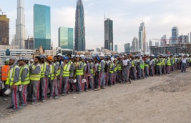
Waiting
Time when work-in-progress or people are waiting for the next step in production.
An example of waiting is a project team waiting for a change order to be approved, resulting in doing work out of the ideal sequence.
This can lead to the waste of over production by one trade and another having to create a work around.

Slide 11
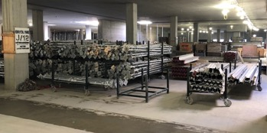
Unnecessary Transportation
Creating inefficient transport, moving materials, parts, equipment or information into or out of storage or between processes.
An example of unnecessary transportation is moving materials around on the site instead of having them placed closest to the install location from the point of delivery.
This can lead to the waste of defects as the risk of materials getting damaged goes up. It also is a form of excess inventory.

Slide 12
Over Processing
Taking unnecessary steps in a process.
An example of over processing is the traditional process of a Request for Information (RFI) passing through so many hands to get a question answered. The average administrative cost of the process is $3,000 per RFI.
This can lead to the wastes of waiting, and unused creativity of team members.
To get an answer to a question………
Trade
GC
Arch.
Eng.
RFI?
RFI?
RFI?
RFI?
RFI!
RFI!
RFI!
RFI!
The average cost to administer an RFI is $3,000/RFI

Slide 13
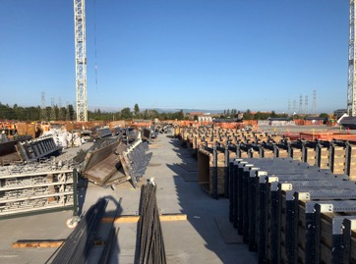
Excess Inventory
Product, materials, work-in-progress or information quantities that go beyond supporting the immediate need. Anything that is a buffer could be explored as waste.
Excess inventory can be thought of as hidden or excess contingency of time, money or space. It also includes over delivery of materials to the site prior to them being ready to be put in place.
This may lead to the wastes of unnecessary transportation, waiting and defects.

Slide 14

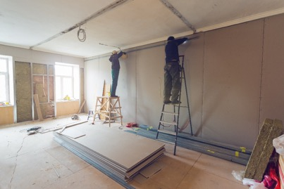
Unnecessary Motion
Unnecessary movement by people or movement that does not add value.
Searching for materials or information.
Examples of unnecessary motion are workers moving up and down ladders or back and forth in a room to get materials or tools instead of the materials and tools moving with them, or searching through file server for files.
This can lead to the wastes of waiting, defects and unused creativity of team members.

Slide 15
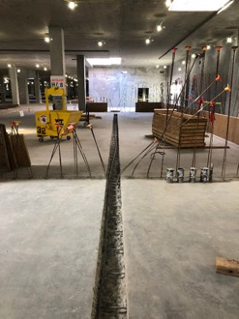
Defects
Production of effective parts, work or information that causes the work to be scrapped, or redone.
Examples of defects include any work that needs to be fixed or redone or accepted in less than desirable state or quality.
This can lead to the wastes of over processing as a traditional punch list process and to waiting and unused creativity of team members.

Slide 16

Unused Creativity of Team Members
Losing time, ideas, skills, improvements and learning opportunities by not engaging or listening to employees.
Examples of unused creativity of team members include not listening to a team member’s ideas for improvement or not creating a culture where people can safely speak up. It includes being in a meeting that seems to have no purpose and not stating such.

Slide 17
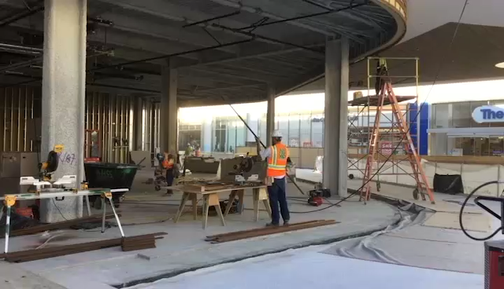
Monique – this and next are short videos!
Waste Walk
Courtesy of KHS&S Contractors
Notes:
This is a video with no sound needed.

Slide 18
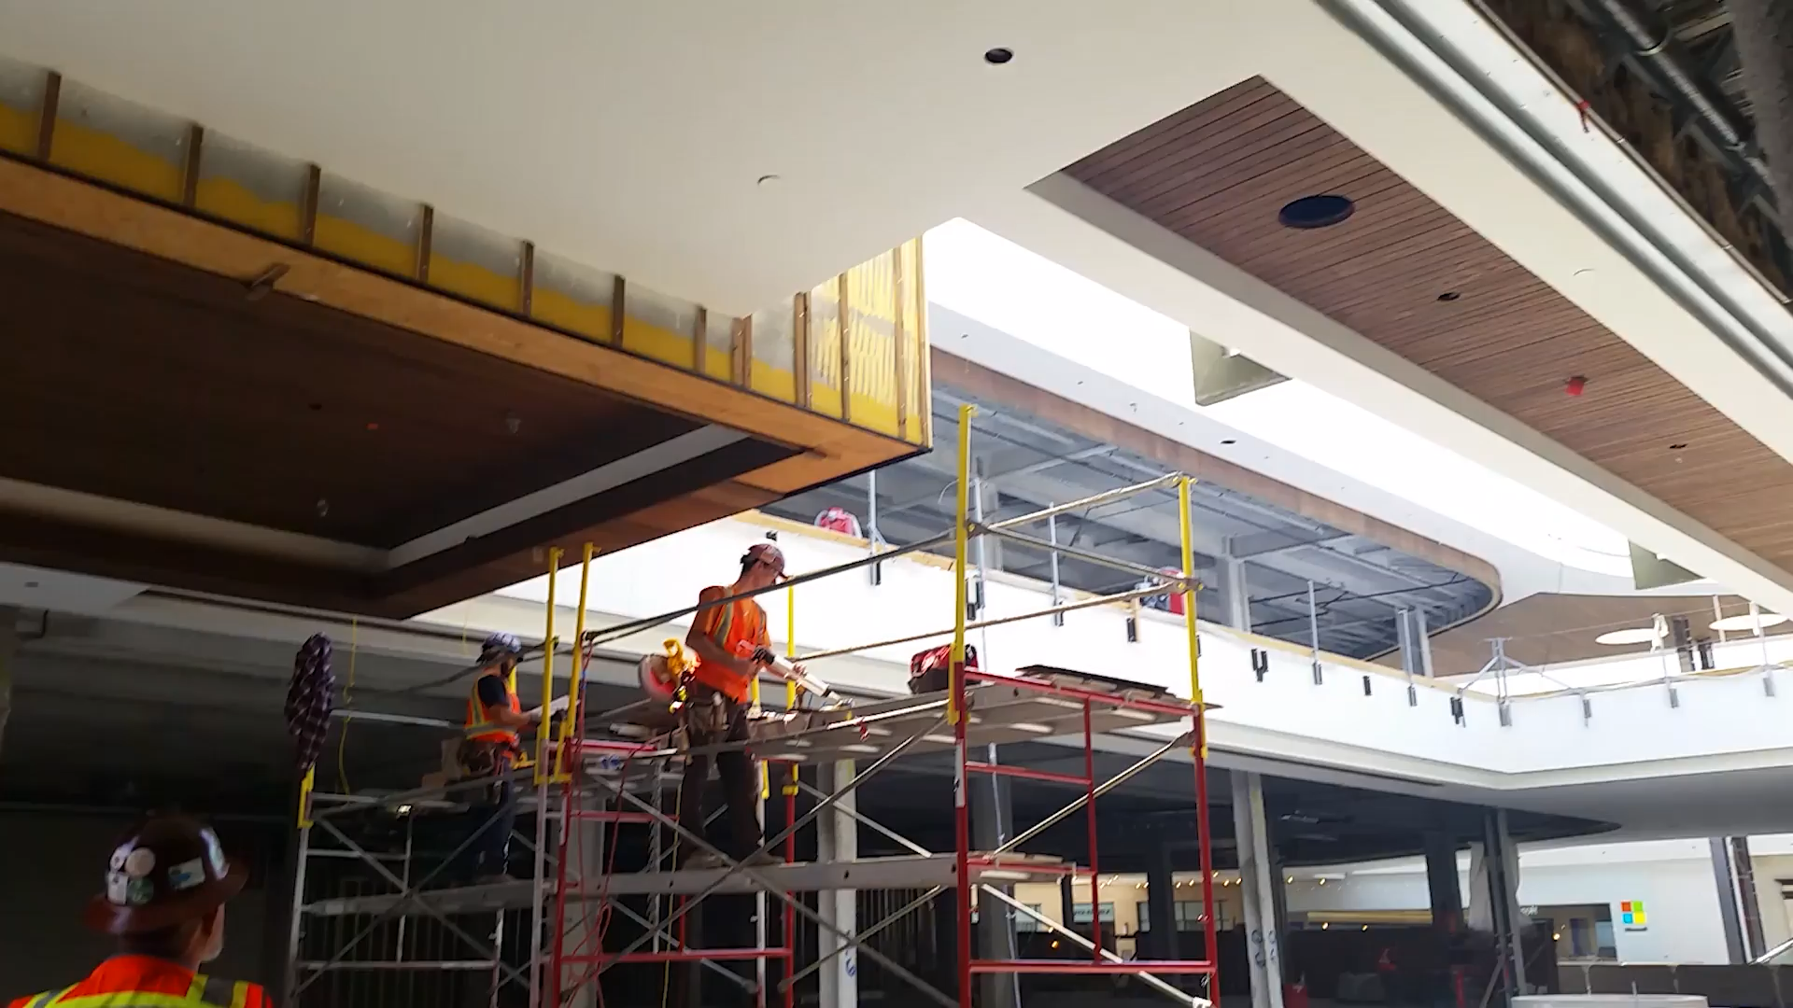
Waste Walk Improvements
Courtesy of KHS&S Contractors
Notes:
Note the improvements to the wasteful actions in the prior video.

Slide 19
Discussion Question
List examples of waste you see in design and construction process
Notes:
This can be done in small groups with a report out or as a whole.

Slide 20
Discussion Question
How to Implement Lean?
What new actions or ideas that you learned today, can you take back to your work?

Slide 21
Lean Journey to Mastery
How will you reach the next level on your journey?
Mastery
Competency
Understanding
Target Value Delivery: Classroom & eLearning (release 2019)
Lean in the Design Phase: Classroom & eLearning
Mindset of an Effective Big Room: Classroom & eLearning (release May 2019)
Last Planner® System in Design: Classroom & eLearning (release 2019)
Conducting Gemba Walks: Classroom
Awareness
Unaware
Introduction to Lean Project Delivery: Classroom, eLearning & Webinar
Introduction to Last Planner® System: Classroom & eLearning
Lean in the Design Phase: Classroom & eLearning
Introduction to Lean in Design-Build: Classroom
The Business Case for Learn: Classroom
Notes:
This version of the Lean Journey to Mastery indicates next levels of learning available through the Lean Construction Institute.

Slide 22



More on Learning
Books:
Events:
Local Community of Practice
Congress (October)
Design Forum (May)
LCI Instructor Program:
Apply to be a LCI Instructor through LCI website
Provides access to teach LCI full courses
Provides access to LCI materials for use
Great to continue the Lean Journey of your company or team
Continue learning now:
www.LeanConstruction.org

Slide 23
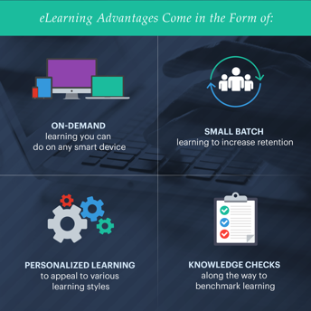
eLearning
Learn on your own time without taking time off project work
Increase knowledge retention by up to 60% with interactive, small-batch learning
Access field resources to use with teams
Earn 1.5 CEUs (self report to AGC CM-Lean and/or AIA)
Incentivize with LCI badging credentials for email signatures and a certificate of completion
Save money by eliminating instructor and travel expenses
  LCI corporate member volume discounts of up to 75% off
  Reduced member pricing is available in addition to standard non-member pricing

Slide 24
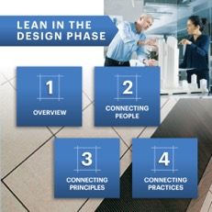
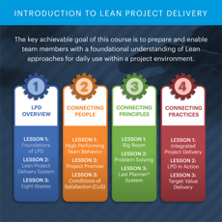
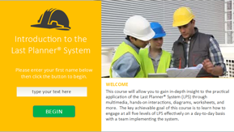
eLearning Courses
Available now:
Introduction to the Last Planner® System
Introduction to Lean Project Delivery
Lean in the Design Phase
Coming soon:
Effective Big Room (June 2019)
Target Value Delivery (Fall 2019)

Slide 25
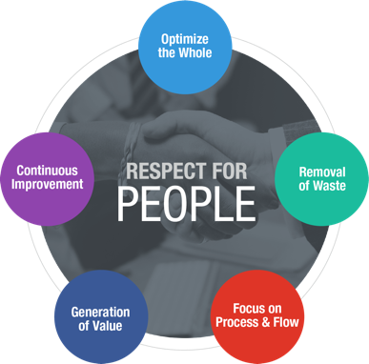
Conduct Plus/Delta
Conduct a Plus/Delta
Capture on a flip pad or white board:
Plus: What produced value during the session?
Delta: What could we change to improve the process or outcome?

Slide 26

Lean Construction Institute
info@leanconstruction.org

